Slide 1
Soldering station
Project ontwerpen
Justice Lacroix
28/05/2024

Slide 2
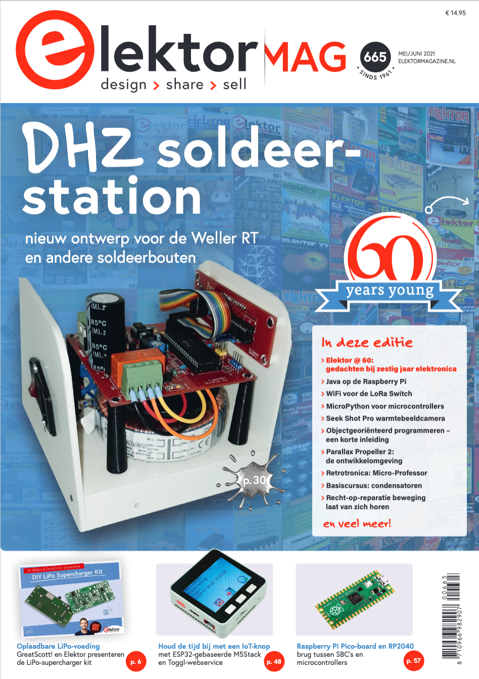
Introduction
The concept
The importance
The guidance

Slide 3
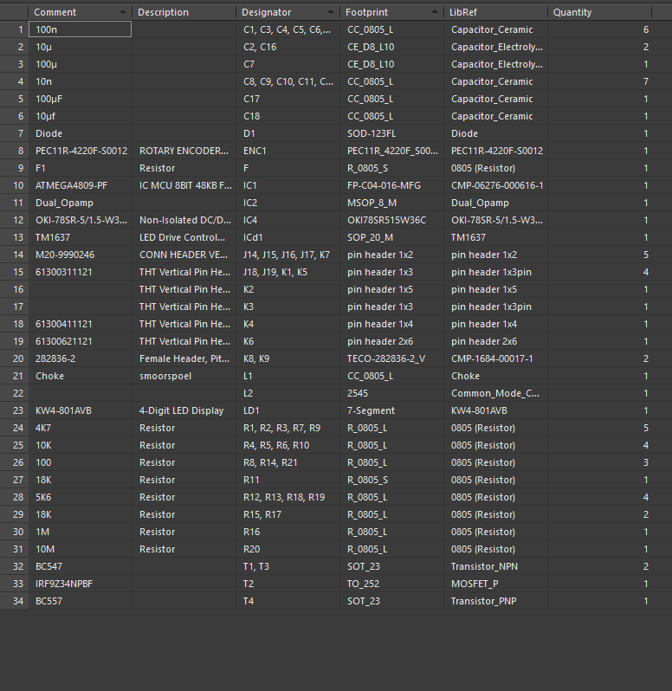

Component sourcing
Bill of Materials
Online buy
Remaining components → Gotron

Slide 4
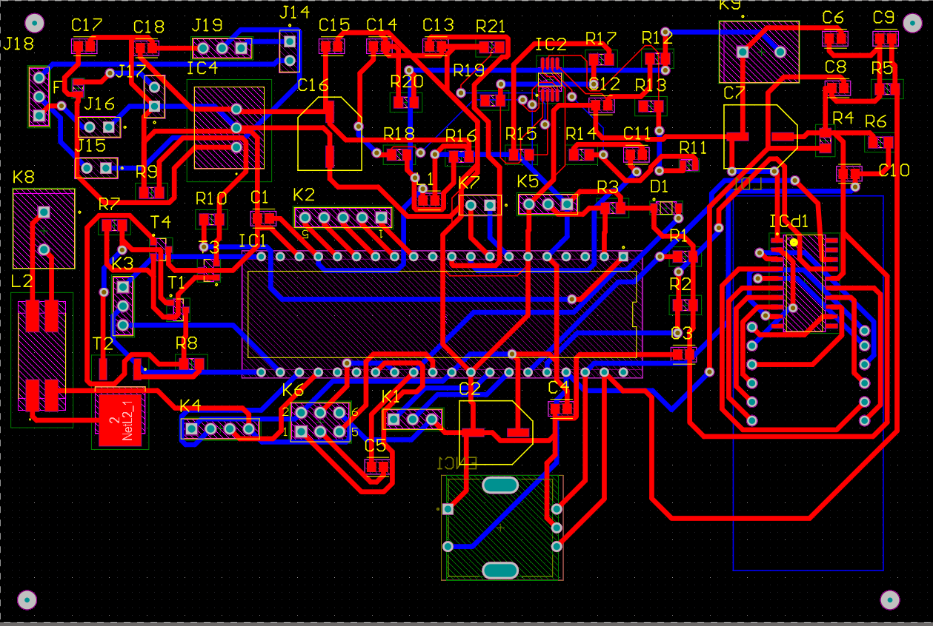
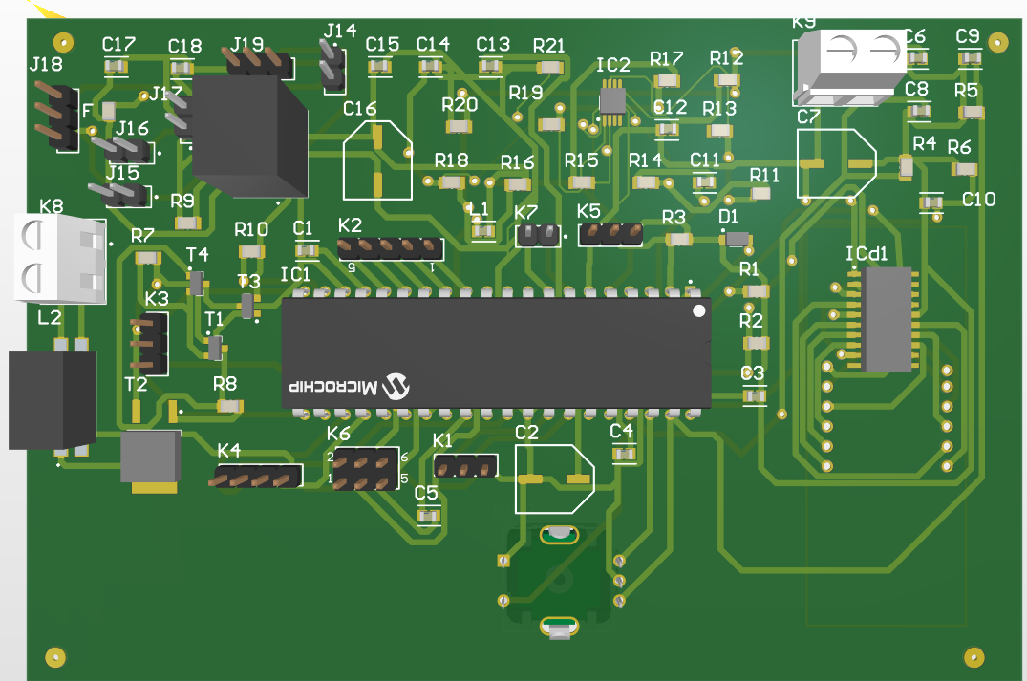
Materials and methods
Starting point → Elektor
The design proces
Schematic modifications
Custom PCB design
Footprints
JLC PCB

Slide 5
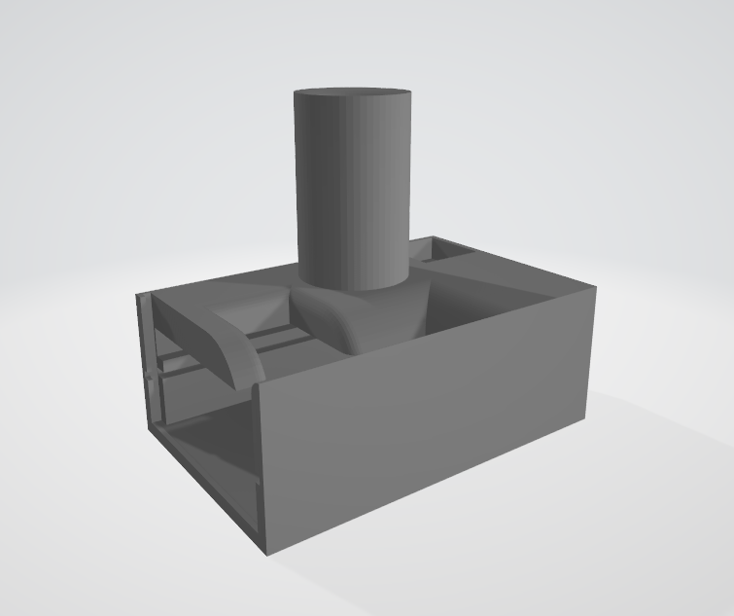
Case design
Fusion 360
The considerations
Dimensions
Necessary openings
The shape
3D printing

Slide 6
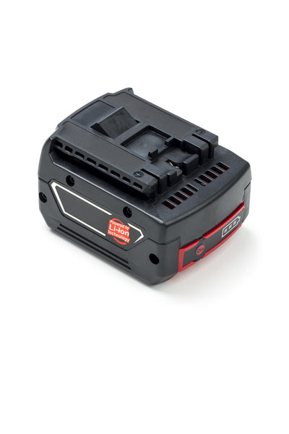
Functionality and features
Temperature control
Display panel
Transportable
battery powered

Slide 7
Testing
Different test conducted
Visual inspection
Voltage measurements
Functional test

Slide 8
Conclusion
Growth in PCB design & case design
time management

Slide 9

The End

